Slide 1

Linux App Service and Container Overview
<your_name>
<date>

Slide 2

Your Name
Your Role
Your Team
Your Focus
You
@twitter
your.name@microsoft.com

Slide 3
Module Overview
Azure App Service on Linux
Containers Recap
Web App for Containers
Single container apps
Multi-container apps
Lab – Deploy a Container to App Service
Java, Python, .NET Core
Notes:
A container image is a lightweight, standalone, executable package of software that includes everything needed to run an application: code, runtime, system tools, system libraries and settings.
Container images become containers at runtime and in the case of Docker containers - images become containers when they run on Docker Engine. Available for both Linux and Windows-based applications, containerized software will always run the same, regardless of the infrastructure.
Docker Containers are everywhere: Linux, Windows, Datacenter, Cloud, Serverless, etc.
Note: Container != Docker. Docker commoditised and democratized containers through develop-focused tooling, APIs, standard packaging and run-time components. However, containers have been around much longer than Docker (est. 2013). Docker open sourced “containerd” (and submitted to the CNCF) the core runtime and image format component so that Docker is not necessarily even needed anymore.

Slide 4
Containers Recap

Slide 5
What is a container?
A standardised way to package applications and their dependencies
A standardised way to run applications with isolation boundaries and resource limits
Many benefits of a virtual machine but lightweight
Portable unit – “Write once, run anywhere”
Notes:
A container image is a lightweight, standalone, executable package of software that includes everything needed to run an application: code, runtime, system tools, system libraries and settings.
Container images become containers at runtime and in the case of Docker containers - images become containers when they run on Docker Engine. Available for both Linux and Windows-based applications, containerized software will always run the same, regardless of the infrastructure.
Docker Containers are everywhere: Linux, Windows, Datacenter, Cloud, Serverless, etc.
Note: Container != Docker. Docker commoditised and democratized containers through develop-focused tooling, APIs, standard packaging and run-time components. However, containers have been around much longer than Docker (est. 2013). Docker open sourced “containerd” (and submitted to the CNCF) the core runtime and image format component so that Docker is not necessarily even needed anymore.

Slide 6
Container timeline
Solaris Containers
chroot
LXC
Rocket
2000
2007
2013
2016
1979
2004
2008
2014
FreeBSD Jails
cgroups
Docker
Windows Containers
Notes:
https://dzone.com/articles/evolution-of-linux-containers-future
1979 — chroot
The concept of containers was started way back in 1979 with UNIX chroot. It’s an UNIX operating-system system call for changing the root directory of a process and it's children to a new location in the filesystem which is only visible to a given process. The idea of this feature is to provide an isolated disk space for each process. Later in 1982 this was added to BSD.
2000 — FreeBSD Jails
FreeBSD Jails is one of the early container technologies introduced by Derrick T. Woolworth at R&D Associates for FreeBSD in year 2000. It is an operating-system system call similar to chroot, but included additional process sandboxing features for isolating the filesystem, users, networking, etc. As a result it could provide means of assigning an IP address for each jail, custom software installations and configurations, etc.
2004 — Solaris Containers
Solaris Containers were introduced for x86 and SPARC systems, first released publicly in February 2004 in build 51 beta of Solaris 10, and subsequently in the first full release of Solaris 10, 2005. A Solaris Container is a combination of system resource controls and the boundary separation provided by zones. Zones act as completely isolated virtual servers within a single operating system instance.
2007 — Control Groups
Process Containers was implemented at Google in year 2006 for limiting, accounting, and isolating resource usage (CPU, memory, disk I/O, network, etc.) of a collection of processes. Later on it was renamed to Control Groups to avoid the confusion multiple meanings of the term “container” in the Linux kernel context and merged to the Linux kernel 2.6.24. This shows how early Google was involved in container technology and how they have contributed back.
As explained above, Control Groups AKA cgroups was implemented by Google and added to the Linux Kernel in 2007.
2008 — LXC
LXC stands for LinuX Containers and it is the first, most complete implementation of Linux container manager. It was implemented using cgroups and Linux namespaces. LXC was delivered in liblxc library and provided language bindings for the API in Python3, Python2, Lua, Go, Ruby, and Haskell. Contrast to other container technologies LXC works on vanila Linux kernel without requiring any patches. Today LXC project is sponsored by Canonical Ltd. and hosted here.
2013 — Docker
Docker is the most popular and widely used container management system as of January 2016. It was developed as an internal project at a platform-as-a-service company called dotCloud and later renamed to Docker. Similar to Warden, Docker also used LXC at the initial stages and later replaced LXC with it’s own library called libcontainer. Unlike any other container platform, Docker introduced an entire ecosystem for managing containers. This includes a highly efficient, layered container image model, a global and local container registries, a clean REST API, a CLI, etc. At a later stage, Docker also took an initiative to implement a container cluster management solution called Docker Swarm.
2014 — Rocket
Rocket is a much similar initiative to Docker started by CoreOS for fixing some of the drawbacks they found in Docker. CoreOS has mentioned that their aim is to provide more rigorous security and production requirements than Docker. More importantly, it is implemented on App Container specifications to be a more open standard. In addition to Rocket, CoreOS also develops several other container related products used by Docker and Kubernetes: CoreOS Operating System, etcd, and flannel.
2016 — Windows Containers
Microsoft also took an initiative to add container support to the Microsoft Windows Server operating system in 2015 for Windows based applications, called Windows Containers. This is to be released with Microsoft Windows Server 2016. With this implementation Docker would be able to run Docker containers on Windows natively without having to run a virtual machine to run Docker (earlier Docker ran on Windows using a Linux VM).

Slide 7


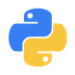

Portability using containers
Any OS
Anywhere
Any app
Any language
Java
Linux
On-premises
Monolith
.Net
Python
Windows
Cloud
Microservice
Node

Slide 8
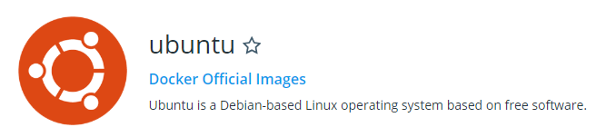
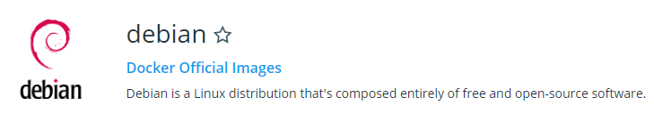
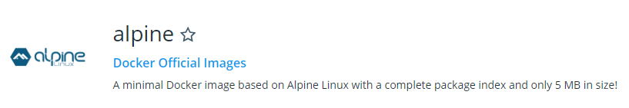
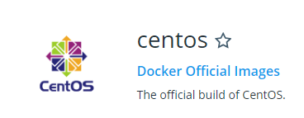
Linux Base Container OS Images
Notes:
If you were deploying into say ARO, you might use the RHEL7 base image - https://access.redhat.com/containers/?tab=overview#/registry.access.redhat.com/rhel7

Slide 9
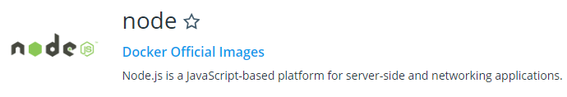
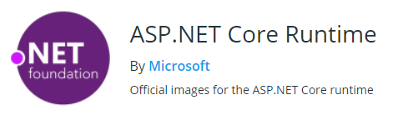
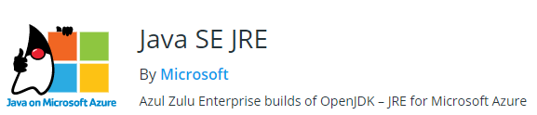


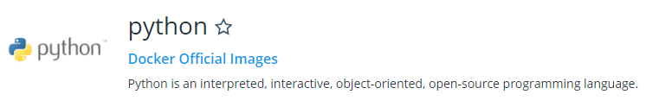
Linux Base Container App Images

Slide 10
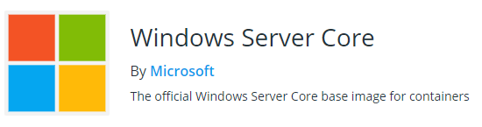
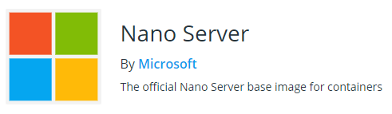
Windows Base Container OS Images

Slide 11
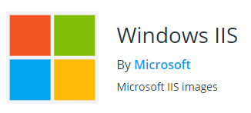



Windows Base Container App Images

Slide 12
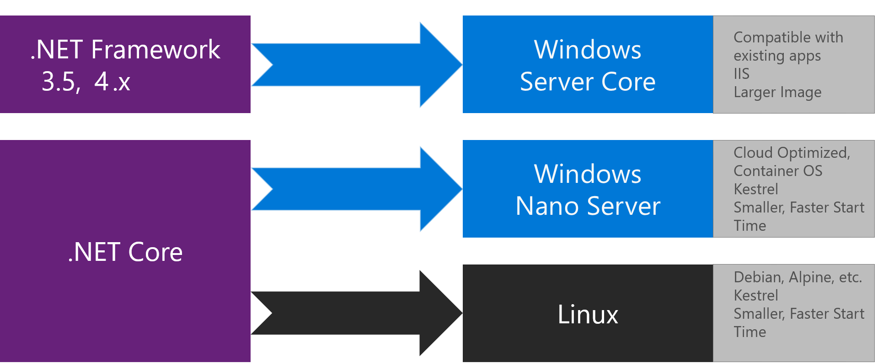
Windows base images
2GB ~ 6GB
140MB ~ 420MB
2MB ~ 50MB
Sources:
https://docs.microsoft.com/en-us/dotnet/standard/microservices-architecture/net-core-net-framework-containers/net-container-os-targets (image),
https://hub.docker.com/r/library/debian/tags/
https://hub.docker.com/r/library/alpine/tags/
https://hub.docker.com/r/microsoft/nanoserver/tags/
https://hub.docker.com/r/microsoft/windowsservercore/tags/
Notes:
Nano Server is "headless;" there is no local logon capability or graphical user interface.
Nano Server is ideal for a number of scenarios:
As a "compute" host for Hyper-V virtual machines, either in clusters or not
As a storage host for Scale-Out File Server.
As a DNS server
As a web server running Kestrel
As a host for applications that are developed using cloud application patterns and run in a container or virtual machine guest operating system

Slide 13



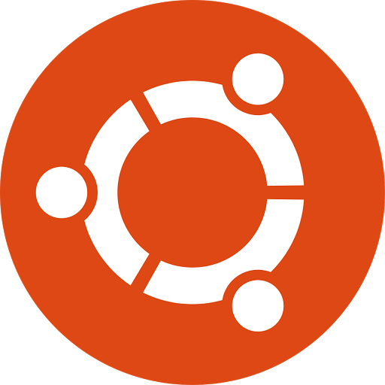
Building an image
Image build process
Docker image
Dockerfile
“my-app:v1”
App
ubuntu
=
Dependencies
+
Source or Binaries
ubuntu
Dependencies
Notes:
Images are layered (you can squash layers into a single layer).
Dockerfile is built – it will fetch dependencies and copy them into the image along with your app binaries.
These can be pre-built artefacts or source code that is built within the image (multistage builds help here to keep images small).

Slide 14

Container Registry
my-app:v1
Container Registry
ubuntu
App
Push
Push
Dependencies
1 Layer
3 Layers
App
ubuntu
ubuntu
Dependencies
1 Layer
ubuntu
2 Layers
App
Dependencies
3 Layers
ubuntu
Pull
Notes:
Here, we see that only layers that are not present on the host or in the remote registry are pushed/pulled. Each layer has a unique hash of it’s contents stored along with the image.
For this diagram, we assume Ubuntu is 1 layer, but in reality it is usually more than that unless the layers are squashed into a single layer.

Slide 15
Containers
Docker Host
Container
<<
b
o
b
>>
Container Registry
my-app:v1
Container
<<
a
l
i
ce
>>
Docker Engine
docker run –name bob my-app:v1;
docker run –name alice my-app:v1
Notes:
Here we show that a single image (which holds read-only layers) can be pulled to then run multiple copies as containers which hold processes and a single writeable layer on top of the image.
Containers are ephemeral. Anything written inside them is lost when the container is deleted.
You can mount volumes into a container (e.g. bind mount from host or use a volume driver like NFS, Azure Disk, Azure Files, etc.)

Slide 16
Dockerfile example
Create a Dockerfile:
Build the image with the docker build command:
List your images:
FROM debian:8
LABEL maintainer=“John Citizen”
RUN apt-get update && \
apt-get install –y nginx
EXPOSE 80
CMD [“nginx”, “-g”, “daemon off;”]
$ docker build –t nginx-demo:1.0.0 .
# Where `.` is the directory containing the `Dockerfile`
$ docker images
REPOSITORY TAG IMAGE ID CREATED SIZE
nginx-demo 1.0.0 ac3b9cb4e821 36 minutes ago 196.2 MB

Slide 17
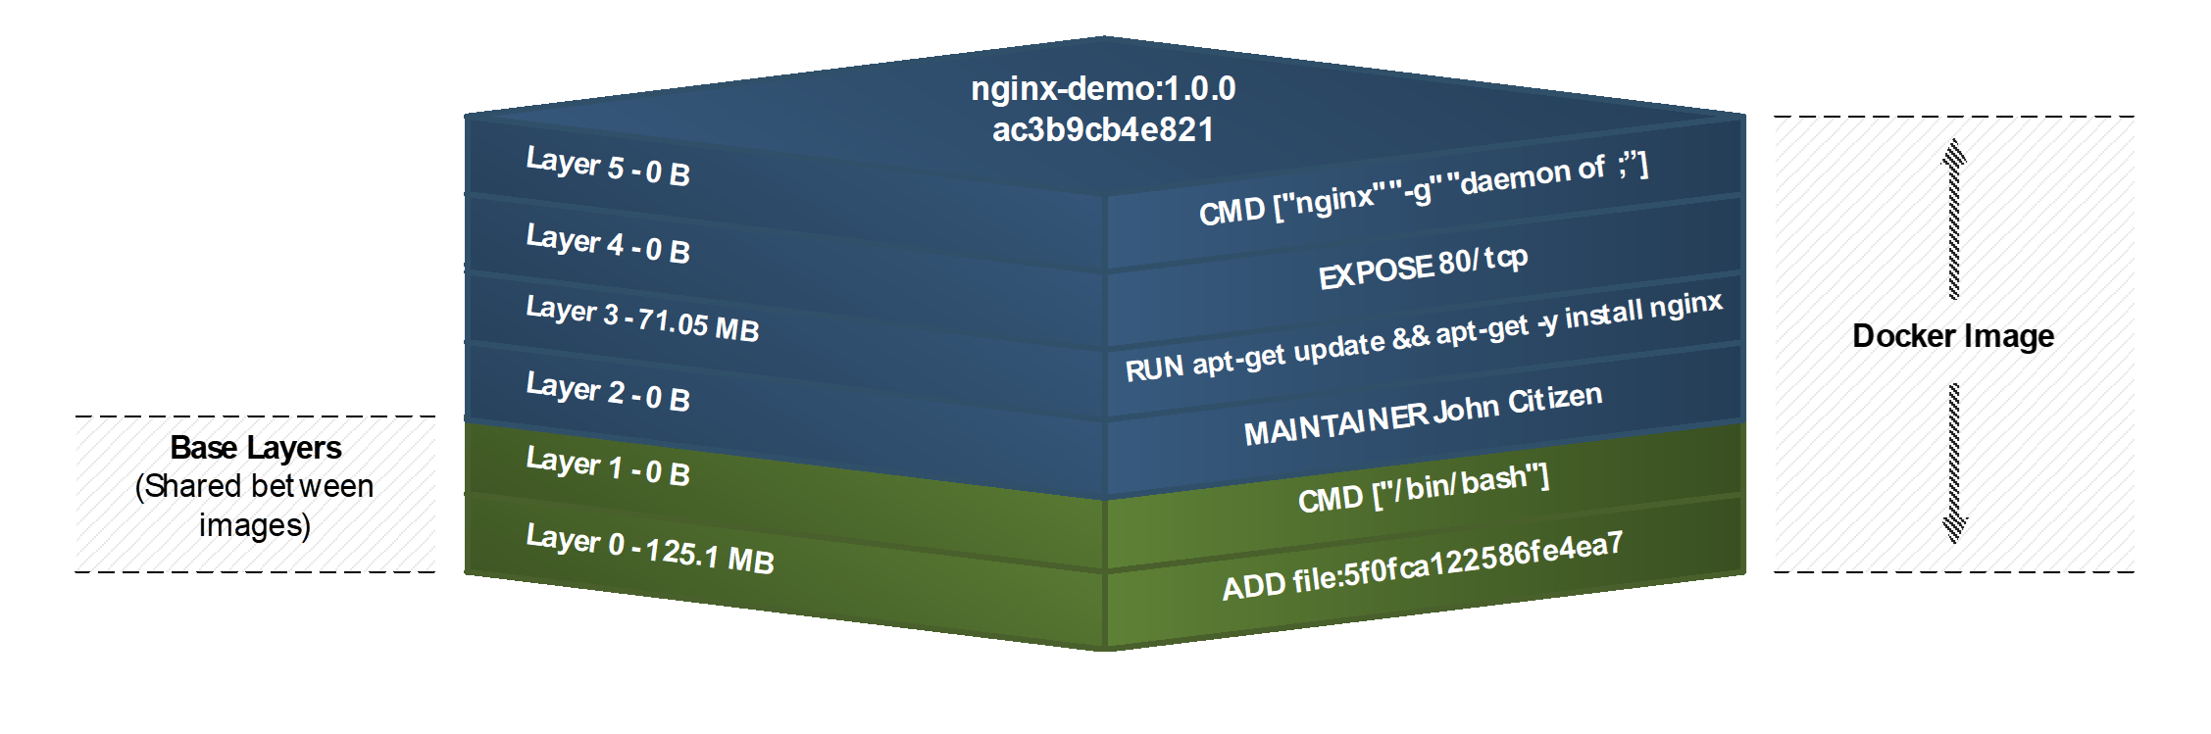
Image produced from docker build
$ docker history nginx-demo:1.0.0
196.2 MB

Slide 18
Azure App Service on Linux

Slide 19
Azure App Service on Linux (Web Apps)
Choose a Linux-based App Service Plan
Supports built-in Linux Docker images for a number of runtimes
Node.js, Java, PHP, Python, .NET Core, Ruby
Continuous deployment
FTP, Git, TFS, GitHub, Azure DevOps and other CI/CD systems
SSH console access through portal or CLI
Notes:
A container image is a lightweight, standalone, executable package of software that includes everything needed to run an application: code, runtime, system tools, system libraries and settings.
Container images become containers at runtime and in the case of Docker containers - images become containers when they run on Docker Engine. Available for both Linux and Windows-based applications, containerized software will always run the same, regardless of the infrastructure.
Docker Containers are everywhere: Linux, Windows, Datacenter, Cloud, Serverless, etc.
Note: Container != Docker. Docker commoditised and democratized containers through develop-focused tooling, APIs, standard packaging and run-time components. However, containers have been around much longer than Docker (est. 2013). Docker open sourced “containerd” (and submitted to the CNCF) the core runtime and image format component so that Docker is not necessarily even needed anymore.

Slide 20
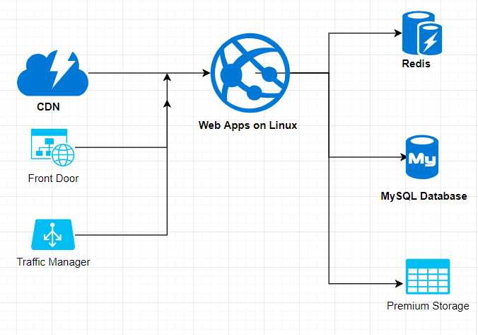
Example Linux Web App
Persistent shared storage is accessible via /home
Use app setting:
WEBSITE_ENABLE_APP_SERVICE_STORAGE=true (default is true)
Or Bring your Own Storage
Premium Storage is supported and essential for file-heavy apps (e.g. PHP, Wordpress)
Notes:
Web App for Containers (single/multi-container) also supports persistent shared storage.
Your app should use port 80 or 8080 (TLS not needed as the platform provides this and terminates TLS for you).
Otherwise, set WEBSITES_PORT to the port your app uses.
Any environment variables needs can be set in App Settings.

Slide 21
Demo – Deploying an app to App Service on Linux

Slide 22
XYZ (abc)

Slide 23
Web App for Containers

Slide 24
Web App for Containers
Choose a Linux-based App Service Plan
Supports custom Linux Docker images of your choice
Single container deployment via a Docker image
Multi-container deployment via a Docker Compose file (public preview)
Continuous deployment
Azure DevOps, TFS, Azure Container Registry, DockerHub
SSH console access through portal or CLI
Notes:
A container image is a lightweight, standalone, executable package of software that includes everything needed to run an application: code, runtime, system tools, system libraries and settings.
Container images become containers at runtime and in the case of Docker containers - images become containers when they run on Docker Engine. Available for both Linux and Windows-based applications, containerized software will always run the same, regardless of the infrastructure.
Docker Containers are everywhere: Linux, Windows, Datacenter, Cloud, Serverless, etc.
Note: Container != Docker. Docker commoditised and democratized containers through develop-focused tooling, APIs, standard packaging and run-time components. However, containers have been around much longer than Docker (est. 2013). Docker open sourced “containerd” (and submitted to the CNCF) the core runtime and image format component so that Docker is not necessarily even needed anymore.

Slide 25
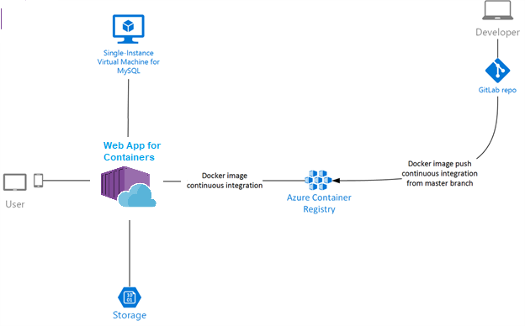
Example Web App for Containers

Slide 26



Custom Docker images for your web apps
Your choice
Dockerfile

Slide 27
Single Container Apps

Slide 28
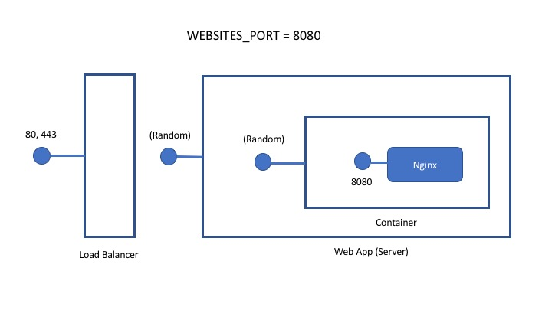
Web App for Containers – Single Container
Notes:
Set WEBSITES_PORT if your container listens on a port other than 80. You don’t need to handle TLS, the platform terminates TLS for you.
az webapp config appsettings set --resource-group <resource-group-name> --name <app-name> --settings WEBSITES_PORT=8000
You can set environment variables for your container via appsettings, just like regular app service apps.
If you need to persist files across restarts then write files to /home and enable WEBSITES_ENABLE_APP_SERVICE_STORAGE (default is true).
az webapp config appsettings set --resource-group <resource-group-name> --name <app-name> --settings WEBSITES_ENABLE_APP_SERVICE_STORAGE=true
/home/LogFiles stores Docker and container logs.
You can bring your own storage (AzureBlob, AzureFiles):
az webapp config storage-account add --resource-group <group_name> --name <app_name> --custom-id <custom_id> --storage-type AzureBlob --share-name <share_name> --account-name <storage_account_name> --access-key "<access_key>" --mount-path <mount_path_directory>
az webapp config storage-account list --resource-group <resource_group> --name <app_name>
Get the custom id, also supported in multi container (docker-compose YAML).
wordpress:
image: wordpress:latest
volumes:
- <custom-id>:<path_in_container>

Slide 29
Creating a Single Container app
Bash with Azure CLI
az group create \
--name <group-name> \
--location <region>
az appservice plan create \
--name <plan-name> \
--resource-group <group-name> \
--sku S1 \
--is-linux
az webapp create \
--resource-group <group-name> \
--plan <plan-name> \
--name <app-name> \
--deployment-container-image-name <docker-image-repo-and-path>

Slide 30
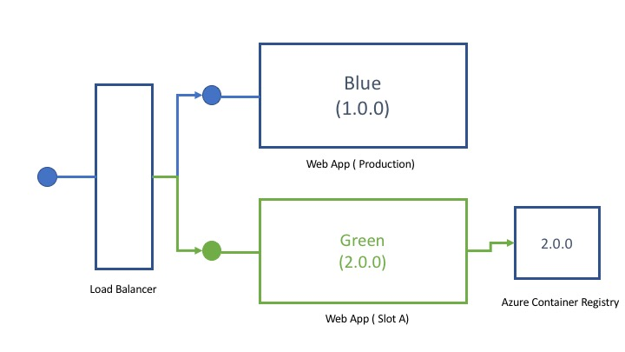
Deployment Slots also work with Containers

Slide 31
Additional things to note
If your container takes longer than 230 seconds to start, set WEBSITES_CONTAINER_START_TIME_LIMIT (max is 1800 sec)
HTTPS is provided and terminated by the platform so you don’t need to handle this in your containers
To access diagnostic logs from your container you need to turn on container logging from portal or CLI

Slide 32
Demo – Single Container App

Slide 33
XYZ (abc)

Slide 34
Multi-Container Apps

Slide 35
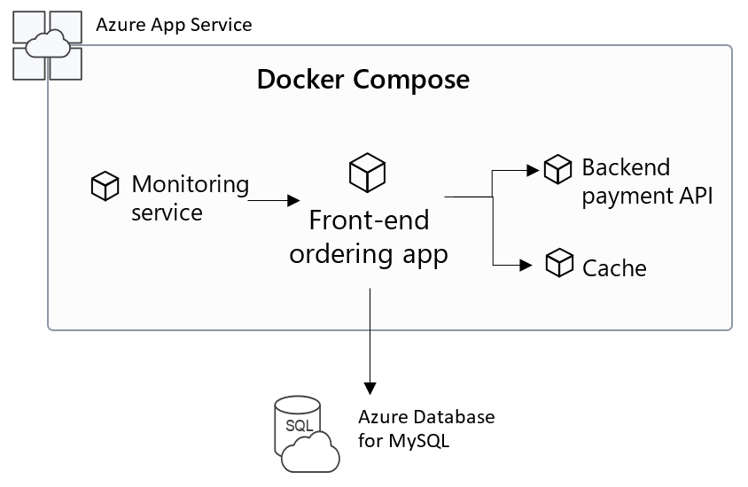
Web App for Containers – Multi-Container
Notes:
You might use NGINX as a reverse proxy in your multi-container deployment so it listens on port 80 or 8080 and reverse proxies to your other containers. Only a single container can serve external traffic.

Slide 36
Creating a Multi-Container app
compose-wordpress.yml
Bash with Azure CLI
version: '3.3'
services:
db:
image: mysql:5.7
volumes:
- db_data:/var/lib/mysql
restart: always
environment:
MYSQL_ROOT_PASSWORD: somewordpress
MYSQL_DATABASE: wordpress
MYSQL_USER: wordpress
MYSQL_PASSWORD: wordpress
wordpress:
depends_on:
- db
image: wordpress:latest
ports:
- "8000:80"
restart: always
environment:
WORDPRESS_DB_HOST: db:3306
WORDPRESS_DB_USER: wordpress
WORDPRESS_DB_PASSWORD: wordpress
volumes:
db_data:
az group create \
--name <group-name> \
--location <region>
az appservice plan create \
--name <plan-name> \
--resource-group <group-name> \
--sku S1 \
--is-linux
az webapp create \
--resource-group myResourceGroup \
--plan myAppServicePlan \
--name <app_name> \
--multicontainer-config-type compose \
--multicontainer-config-file compose-wordpress.yml

Slide 37
Additional things to note
If your container takes longer than 230 seconds to start, set WEBSITES_CONTAINER_START_TIME_LIMIT (max is 1800 sec)
Only one port can be exposed; use a reverse proxy – like NGINX – to expose one port and proxy to your other containers
HTTPS is provided and terminated by the platform so you don’t need to handle this in your containers
If you choose ACR for your images then all images for the webapp need to be in the same ACR

Slide 38
Additional things to note (cont.)
To use SSH, you need to install openssh-server in your images
Persistent storage works with docker-compose deployments (use volumes section and ${WEBAPP_STORAGE_HOME} variable)
Features not supported in Public preview:
Authentication / Authorization
Managed Identities
Unsupported Docker compose options:
Not allowed: build
Ignored: depends_on, networks, secrets, ports (other than 80 and 8080)

Slide 39
Demo - Multi-Container App

Slide 40
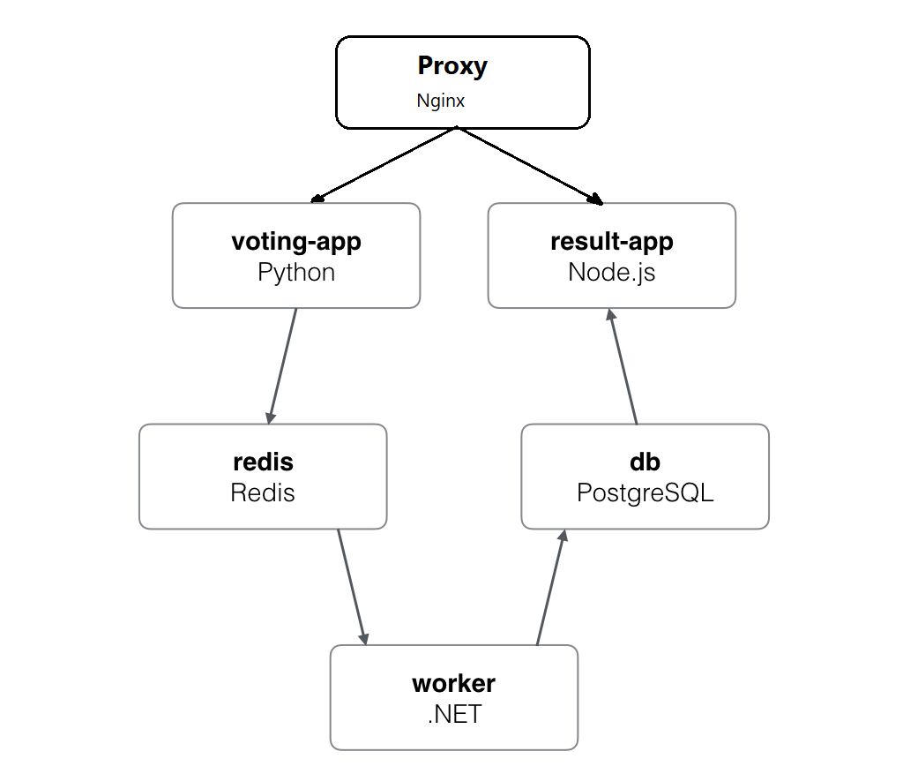
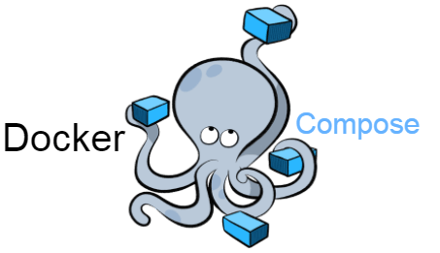

Example Voting App (adapted for App Service)
Source: https://github.com/clarenceb/example-voting-app

Slide 41
Lab - Deploy a Container to App Service

Slide 42
Placeholder – for hands-on lab guide
Access lab repo: https://github.com/<account>/<repo>
Notes:
https://docs.microsoft.com/en-us/azure/app-service/containers/tutorial-php-mysql-app
Run locally
Deploy to App Service (git deploy)
- Make a change and redeploy: https://docs.microsoft.com/en-us/azure/app-service/containers/tutorial-php-mysql-app#update-the-view
Build Docker Image
Deploy to ACI
Deploy to AKS

Slide 43
Additional Resources

Slide 44
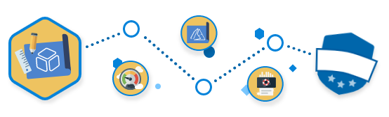
Microsoft Learn
Deploy and run a containerized web app with Azure App Service
Host a web application with Azure App service
Notes:
Microsoft Cloud Workshops could be a starting point for some of these group architecting scenarios.

Slide 45
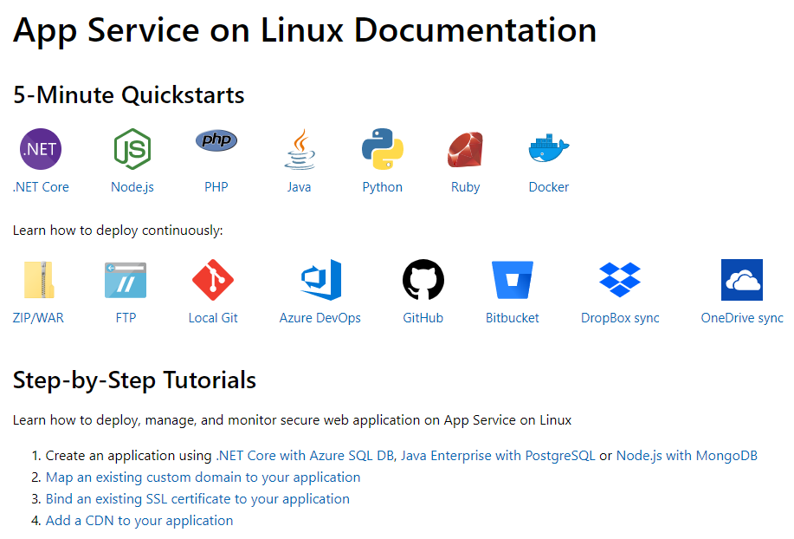
App Service on Linux Documentation
https://docs.microsoft.com/en-us/azure/app-service/containers/

